Slide 1
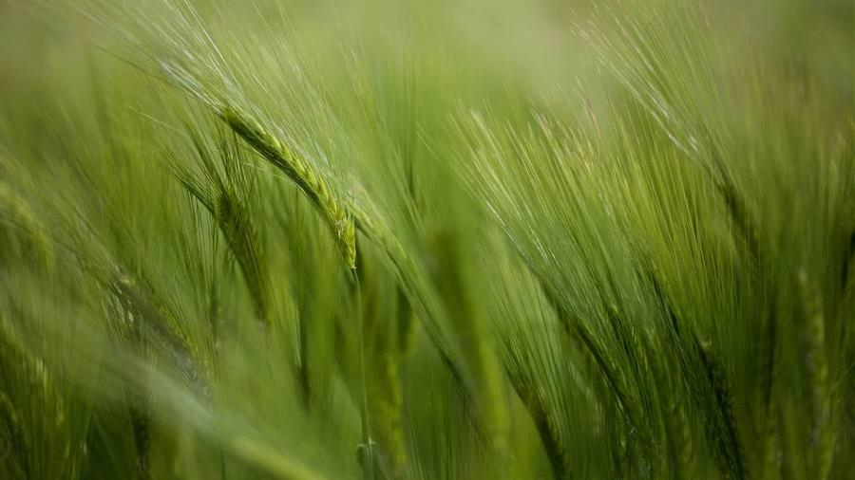
New South wales grazing study
Mel Beall
Nashville Software School - Data Analytics Cohort 9

Slide 2
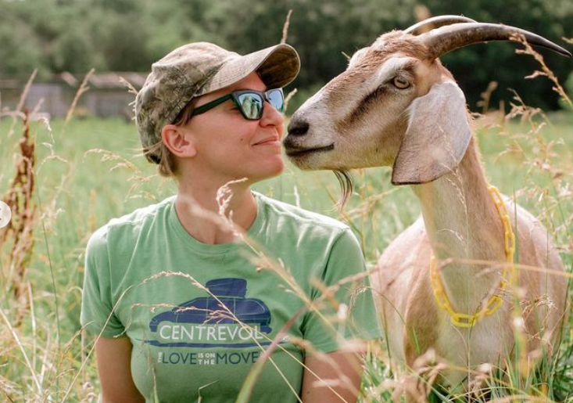
Motivation
yARN
Customers
Organic agriculture continues to be consumer driven, but we're seeing a lapse of availability in the market for organic products
6.6% increase of retail sales of organic food proves that there's consumer interest for more organic produce
Usability
Retail organic food sales were up by $112 billion in 20XX
Financials
Customers want something that's healthy and available to pick up at their local supermarket or area

Slide 3
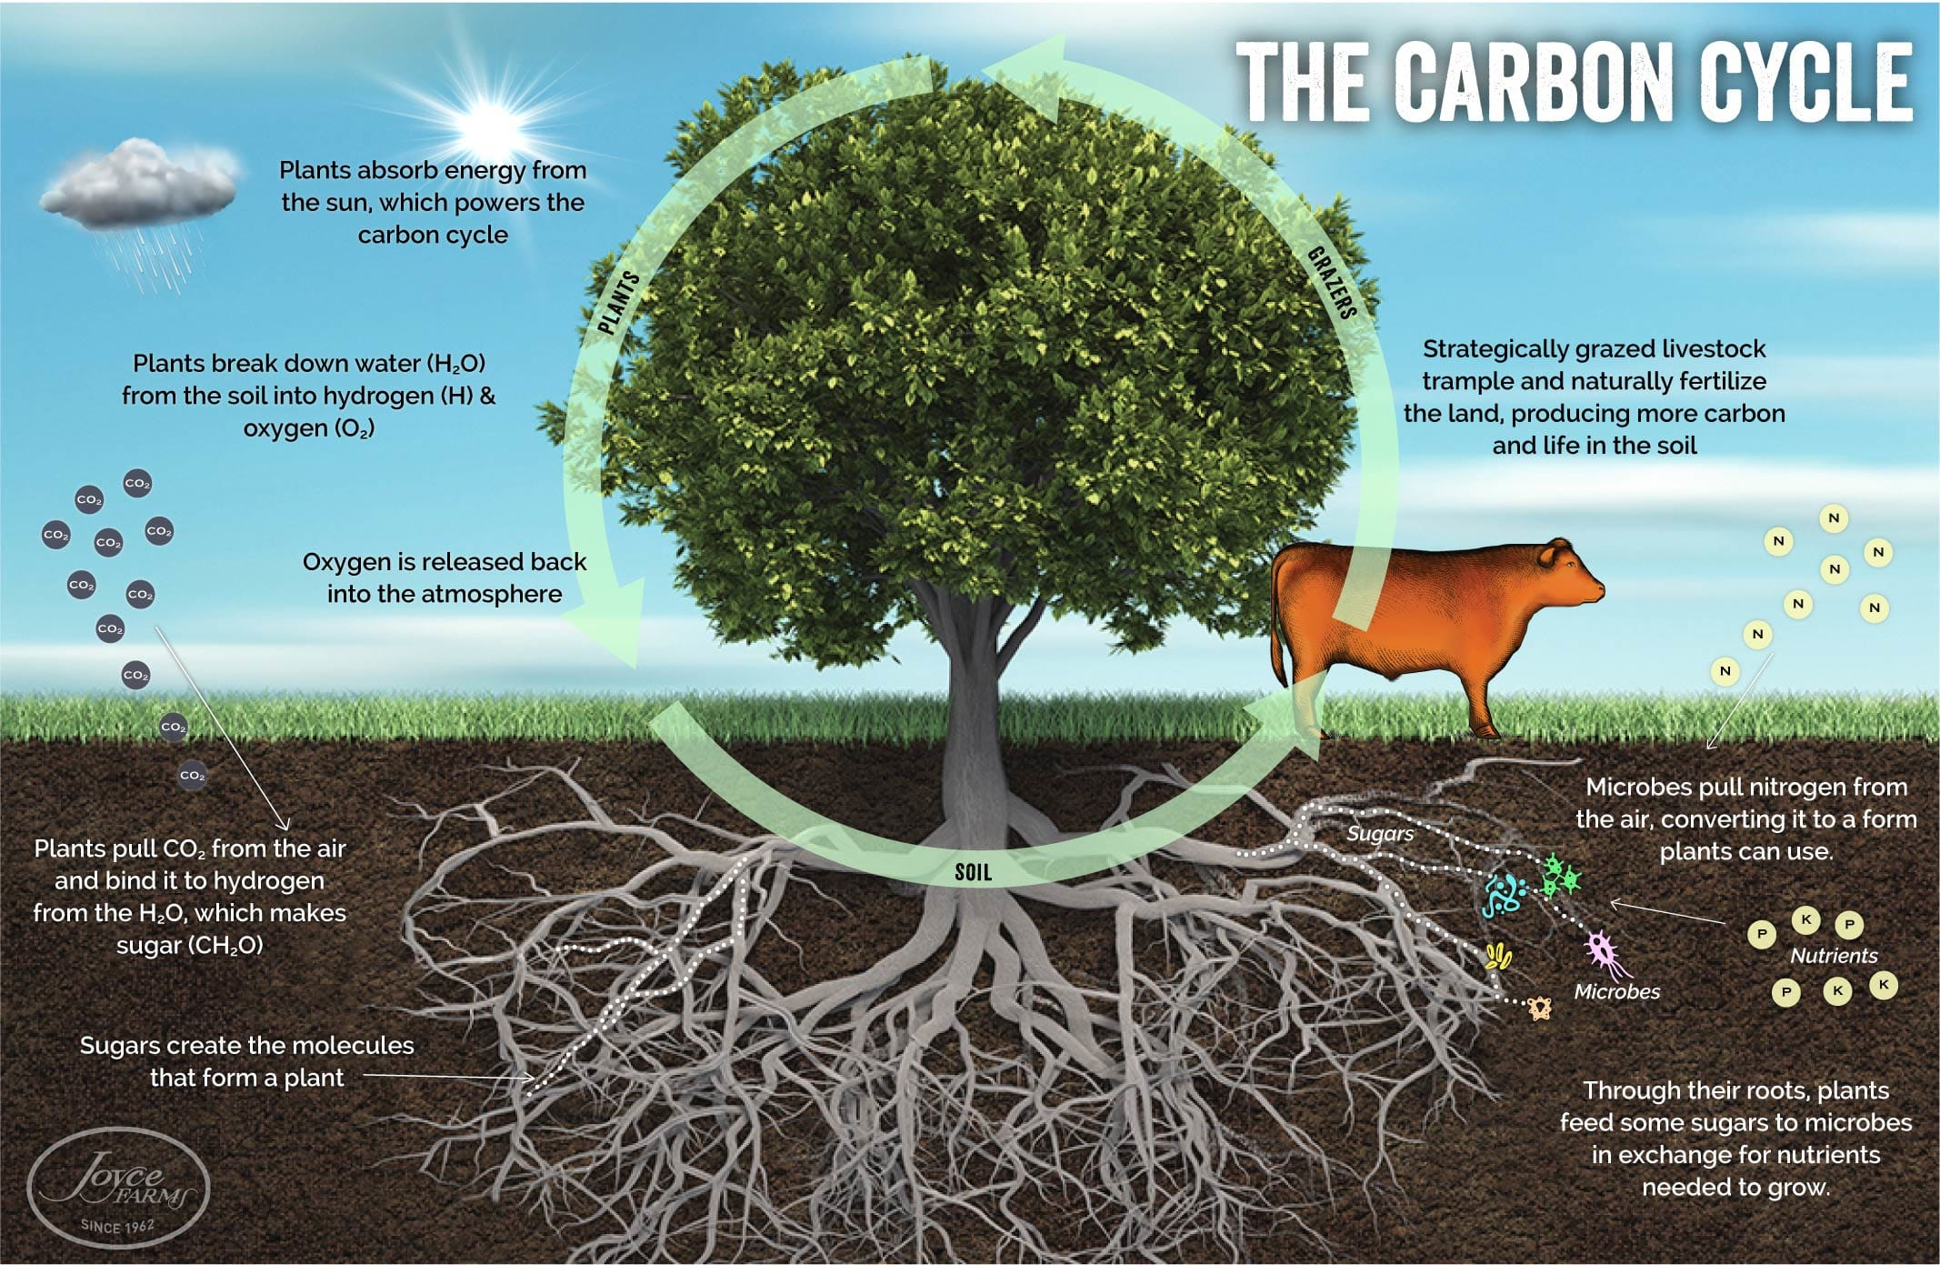
The carbon Cycle
The final piece of the carbon cycle is grazing.
Image courtesy of Dr. Allen Williams, Ph.D.
The Circle of Life: How the Carbon Cycle Powers our Ecosystem — Northeast Recycling Council (nerc.org)

Slide 4
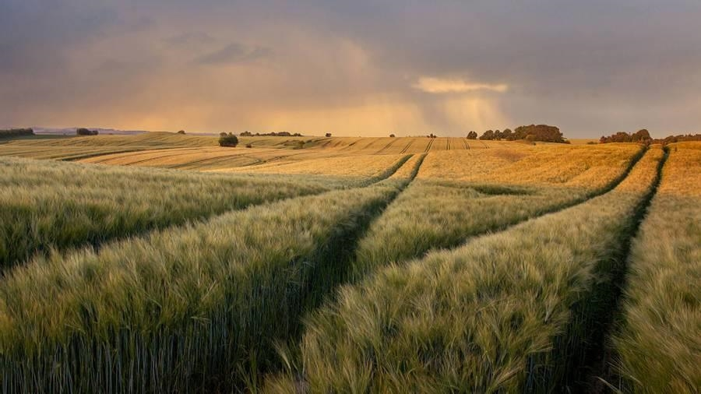
project overview

Slide 5
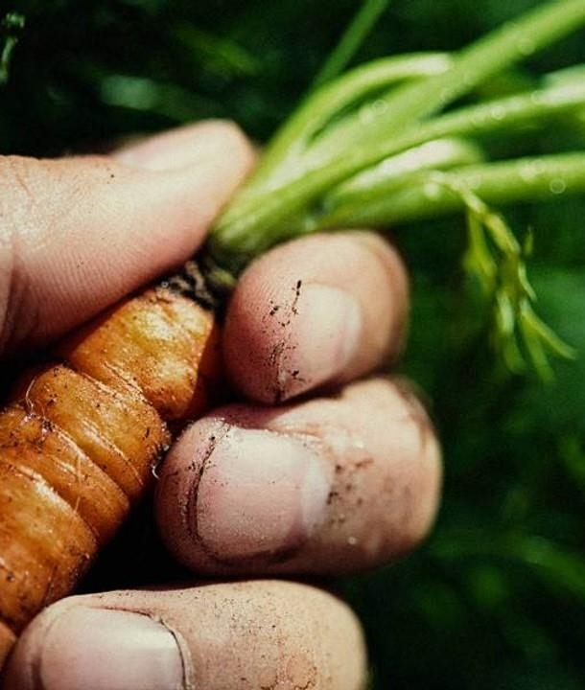
project overview
1​
Evaluate the primary indicators correlated to soil health
2
Evaluate which animals have the largest impact on soil health
3
​Identify key factors in impactful animals grazing

Slide 6
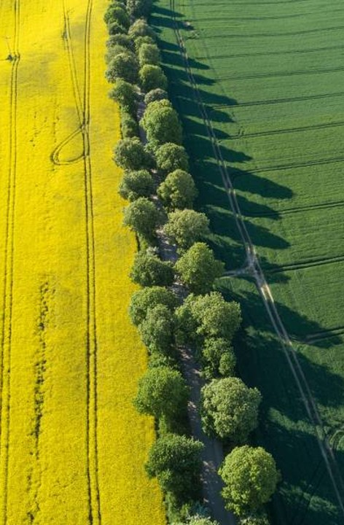
solution
Close the gap
Target audience
Our product makes organic farming easier, and no other product on the market offers the same benefits or yield
Gen Z (18-25 years old)
Cost savings
Easy to use
Reduce expenses for replacement products
A simple product that gives customers the information they need to produce an abundance of rich produce

Slide 7




Product overview
Unique
First to market
Tested
Authentic
Only product specifically dedicated to the agricultural market
First beautifully designed product that's both stylish and functional
Conducted testing with young farmers in the area
Designed with the help and input of agricultural experts in the field

Slide 8

Product benefits
Cool and stylish product​
Areas for community connections ​
Online store and market swap

Slide 9

Business model
research
We based our research on market trends and social media​
abstract
We believe people need more products specifically dedicated to this niche market​
design
Minimalist and easy to use ​

Slide 10

Market comparison
$3b
$2b
$1B
Opportunity to build
Freedom to invent
Few competitors
Addressable market​
Serviceable market​
Obtainable market​

Slide 11
Competitive layout
convenient
contoso
A
Expensive​
affordable
b
D
c
E
Inconvenient​

Slide 12

Growth strategy
How we’ll scale in the future​
Feb 20xx
Roll out product to local farms in the region to help establish the product​
May 20xx
Release the product to the public and monitor press and regional market trends​
Oct 20xx
Gather feedback from the agriculture and farming community to expand availability of the product​

Slide 13
2-year action plan
Get volunteers​
Gather feedback​
Deliver to consumers​
20XX
Jan
Feb
Mar
Apr
May
Jun
Jul
Aug
Sep
Oct
Nov
Dec
Run focus groups​
Test with farms​
Regional launch​
20XX
Jan
Feb
Mar
Apr
May
Jun
Jul
Aug
Sep
Oct
Nov
Dec

Slide 14
Traction
Forecasting for success​
Metrics
Revenue by year
 | clients | orders | Gross avenue | Net revenue
20XX​ | 10​ | 1,100​ | $10,000​ | $7,000​
20XX​ | 20​ | 200​ | $20,000​ | $16,000​
20XX​ | 30​ | 300​ | $30,000​ | $25,000​
20XX​ | 40​ | 400​ | $40,000​ | $30,000​

Slide 15
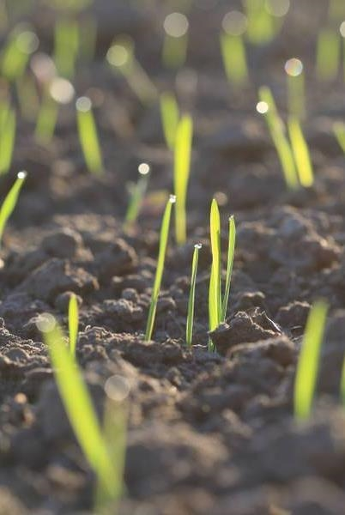
financials
 | Year 1 | Year 2 | year 3
Retailers​ | 5,000​ | 40,000​ | 160,000​ | ​
Users​ | 50,000​ | 400,000​ | 1,600,000​ | ​
Sales​ | 500,000​ | 4,000,000​ | 16,000,000​ | ​
Average Price per Sale​ | 75​ | 80​ | 90​ | ​
Revenue @ 15%​ | 5,625,000​ | 48,000,000​ | 216,000,000​ | ​
Gross Profit​ | 5,625,000​ | 48,000,000​ | 216,000,000​ | ​
Expenses​ | ​ | ​ | ​ | ​
Sales & Marketing​ | 5,062,500​ | 38,400,000​ | 151,200,000​ | ​
Customer Service​ | 1,687,500​ | 9,600,000​ | 21,600,000​ | 70%​
Product Development​ | 562,500​ | 2,400,000​ | 10,800,000​ | 10%​
Research​ | 281,250​ | 2,400,000​ | 4,320,000​ | 5%​
Total Expenses​ | 7,593,750​ | 52,800,000​ | 187,920,000​ | 2%​
EBIT | -1,968,750 | -4,800,000 | 28,080,000 | ​

Slide 16
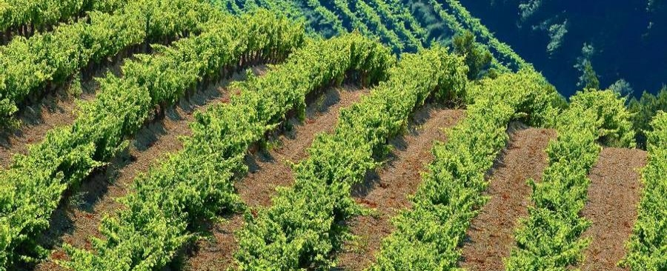
summary
Summary

Slide 17
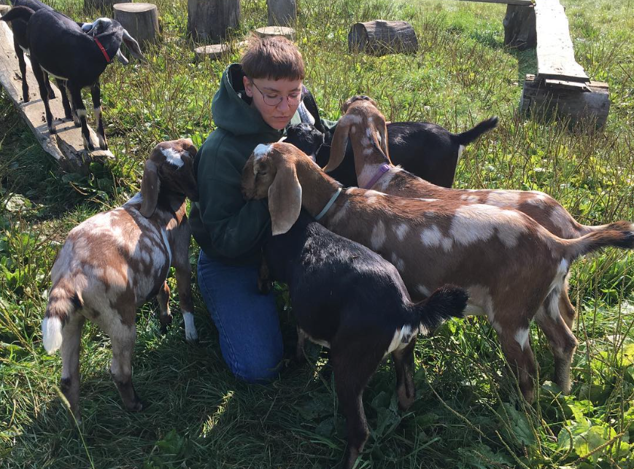
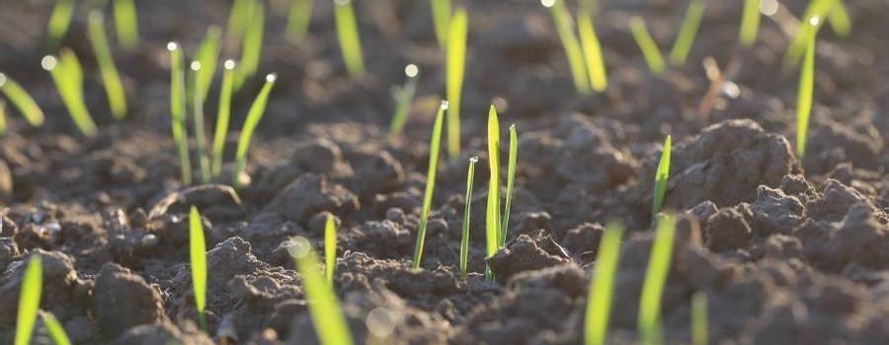
RECOMMENDATIONS
GOAT PILE
GET ABSOLUTELY BURIED BY A PILE OF BABY GOATS OR SHEEP IF POSSIBLE
Competitors
Company A​ Product is more expensive​
Companies B & C ​ Product is expensive and inconvenient to use​
Companies D & E​ Product is affordable, but inconvenient to use

Slide 18
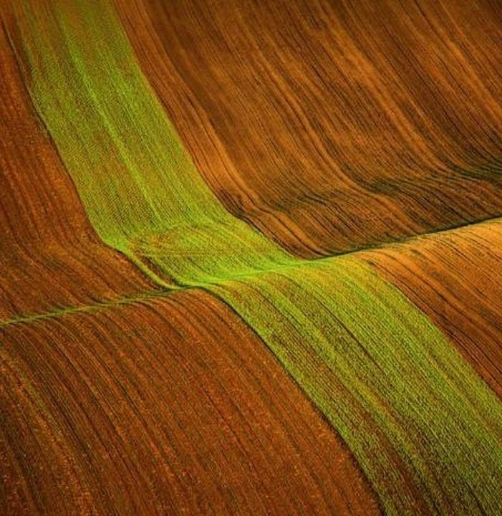
Thank you
Mel Beall​​
Nashville Software School​
Data Analysis Cohort 9
www.contoso.com​

